Slide 1
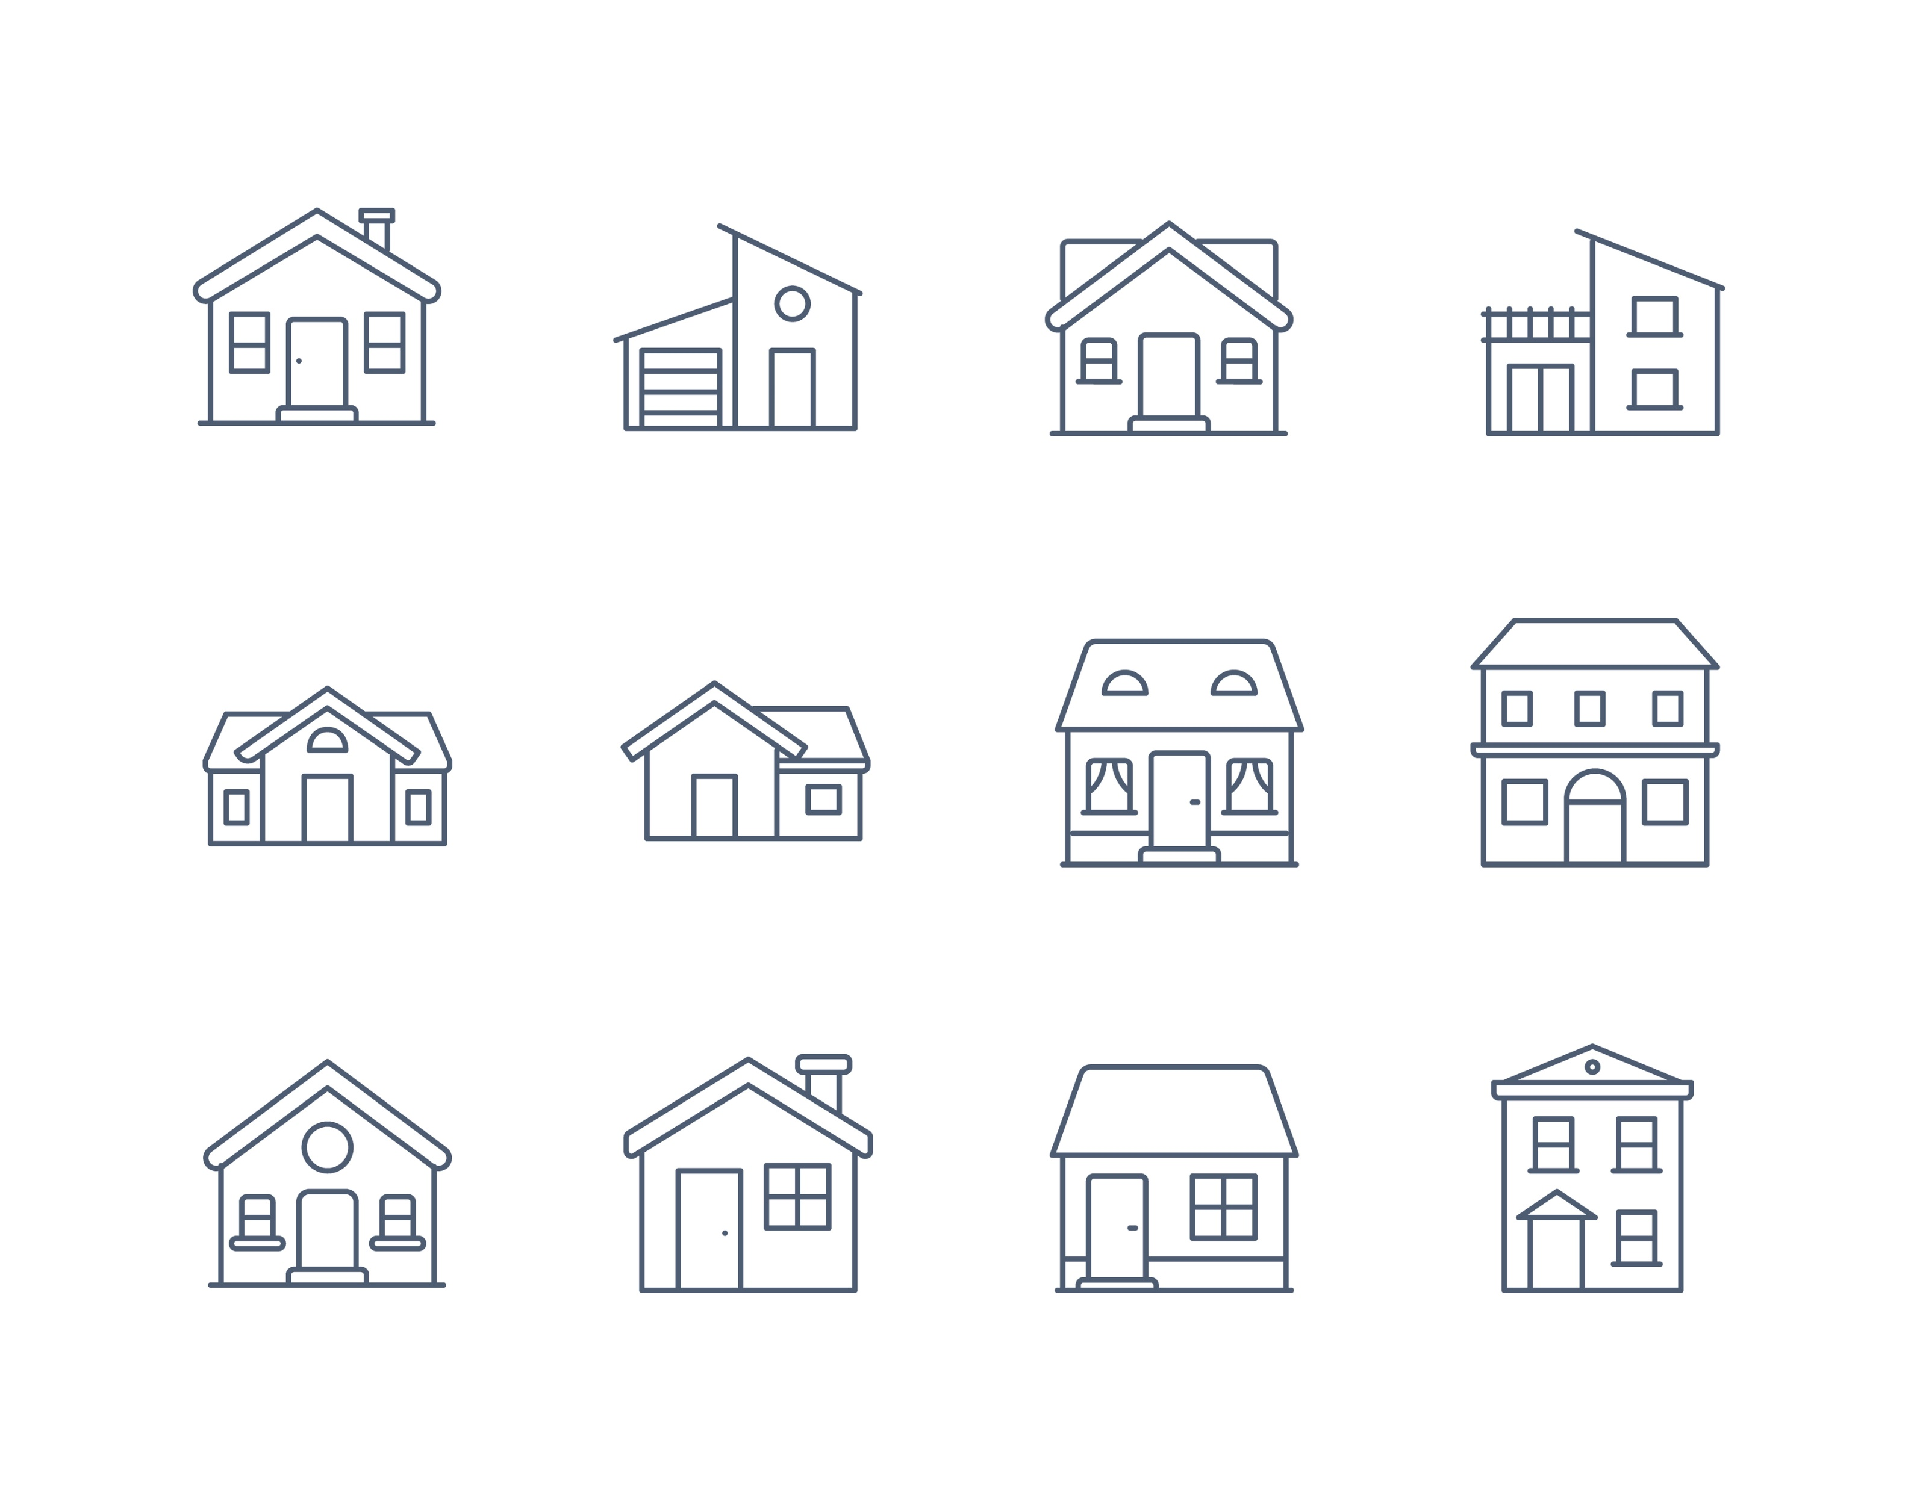
Influences on Home Prices
Presentation by Kelley Council

Slide 2
Presentation Goal
The goal of this presentation is to review data regarding home prices and find what influences them so as to make more profitable investments.

Slide 3
Overview
The data set covers 1,460 homes sold in Ames, IA from 2006 to 2010.
Home Price -
Average: $181,000
Maximum: $755,000
Minimum: $35,000

Slide 4
Hypotheses Overview
Hip Style Roof compared to Gable Style Roof
Alley access compared to no alley
Seasonal influence – Winter compared to Summer and Spring compared to Fall

Slide 5
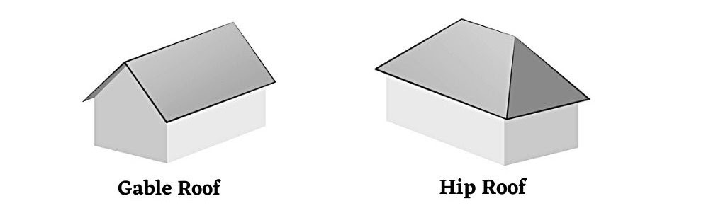
Hip Roof vs. Gable Roof

Slide 6
Hip Roof vs. Gable Roof
H_{o}: μ₁ - μ₂ = 0
H_{a}: μ₁ - μ₂ ≠ 0
P-value: 2.81e⁻¹¹
Since our p-value is less than our alpha of 0.05 we reject the null hypothesis.
 | Hip Roof | Gable Roof
Observations | 286 | 1141
Lower Confidence Interval | 205,902 | 167,621
Upper Confidence Interval | 231,852 | 175,347

Slide 7
Hip Roof vs. Gable Roof
We found with 95% confidence that the Hip Style Roof has a selling price between $34,000 and $61,000 higher than homes with the Gable Style Roof.

Slide 8
Alley vs. No Alley
H_{o}: μ₁ - μ₂ = 0
H_{a}: μ₁ - μ₂ ≠ 0
P-value: 2.281e⁻¹³
Since our p-value is less than our alpha of 0.05 we reject the null hypothesis.
 | Alley | No Alley
Observations | 91 | 1369
Lower Confidence Interval | 133,960 | 179,141
Upper Confidence Interval | 151,732 | 187,763

Slide 9
Alley vs. No Alley
We found with 95% confidence that having access to an alley has a selling price between $31,000 and $50,000 lower than homes that don’t have access to an alley.

Slide 10
Seasonal Sales – Winter vs. Summer
H_{o}: μ₁ - μ₂ = 0
H_{a}: μ₁ - μ₂ ≠ 0
P-value: 0.945348641
Since our p-value is greater than our alpha of 0.05 we fail to reject the null hypothesis.
 | Winter | Summer
Observations | 168 | 608
Lower Confidence Interval | 169,367 | 175,740
Upper Confidence Interval | 195,810 | 188,415

Slide 11
Seasonal Sales – Winter vs. Summer
We are 95% confident that the home price difference would be between ($14,000) and $15,000 in the winter compared to the summer.
Meaning we cannot say with any certainty if it would be better to sell in the winter or summer.

Slide 12
Seasonal Sales – Spring vs. Fall
H_{o}: μ₁ - μ₂ = 0
H_{a}: μ₁ - μ₂ ≠ 0
P-value: 0.035398811
Since our p-value is less than our alpha of 0.05 we reject the null hypothesis.
 | Spring | Fall
Observations | 450 | 230
Lower Confidence Interval | 167,584 | 177,687
Upper Confidence Interval | 181,643 | 198,577

Slide 13
Seasonal Sales – Spring vs. Fall
We found with 95% confidence a home sold in the spring would result in a selling price of between $930 and $26,000 less than a house sold in the fall.

Slide 14
Recommendations
Going forward when looking for investments, homes with Hip Style Roofs and No Alley access have the higher selling prices.
Additionally, it seems purchasing homes in the Spring when prices are generally at their lowest then selling them in the Fall when prices are at their highest would be the best cycle for investments.

Slide 15
Future Testing
Further analysis on the reasons behind the price discrepancies for both the alley and roof tests.
Year built
Neighborhood
Depending on remodeling data, it could be beneficial to purchase a home in the spring, remodel, and sell in the fall.

Slide 16
Thank you! Any Questions?

